Slide 1
Breast Cancer Prediction
Utsav Jitendrabhai Patel(N01516259)
ITE 5201 Humber College 1

Slide 2
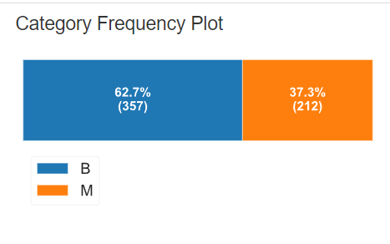
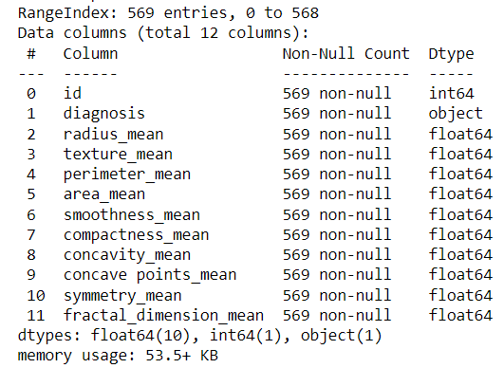
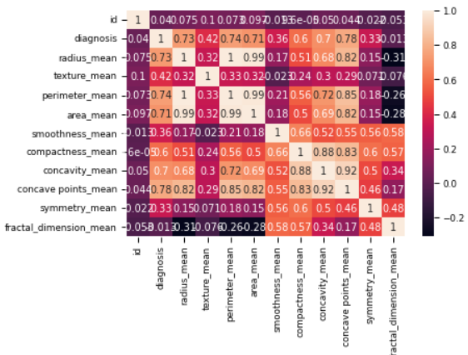
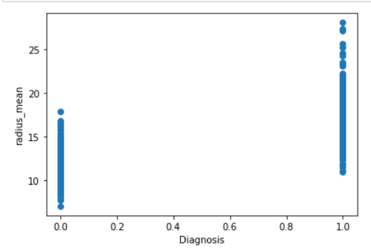
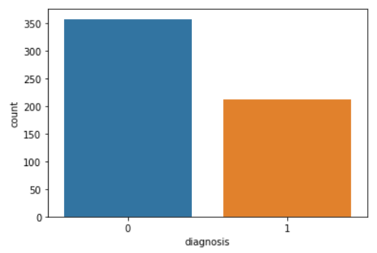
Problem Statement and Dataset Discussion
Problem Statement: To classify that the specific cancer node is malignant or benign by observing parameters.
Dataset Discussion: The used dataset carries the information regarding the cancer nodes observed in various patients. These parameters include Diagnosis (Diagnosis of breast tissue<M, B>), radius_mean (mean of the distances from center to points on the parameter), perimeter_mean (The mean size of the core tumor), texture_mean (standard deviation of gray-scale values) and so on.
In this dataset Id has unique values. Diagnosis is highly correlated with radius_mean, area_mean is highly correlated with radius_mean, Perimeter_mean is also highly correlated with the radius_mean etc. I used scatter plot for diagnosis and radius_mean and count plot for diagnosis.

Slide 3
Proposed Predictive Model
My output node is categorical, So I decided to make Logistic regression, KNN and Random Forest.
I stored all the factor’s value in the x variable apart from diagnosis and value of diagnosis factor in the y variable. And then I split the data in 30% and 70% for test and train respectively. And then predicted the three models using that.
I designed confusion matrix and classification report and based on that I designed confusion matrix diagram and evaluation of predicted data. I wanted to choose these three models because for categorical these models give accurate prediction.

Slide 4

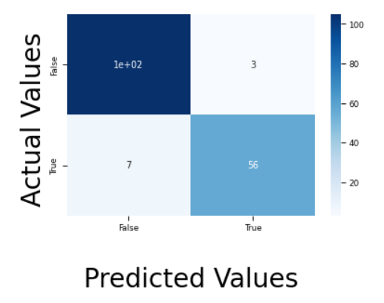
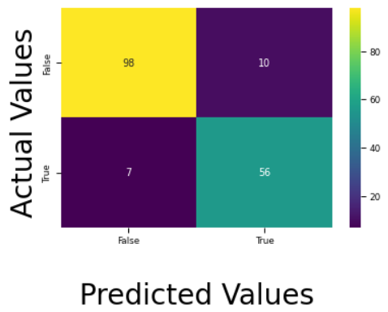
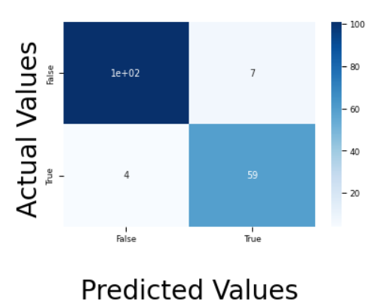
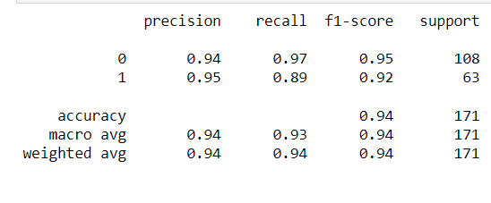
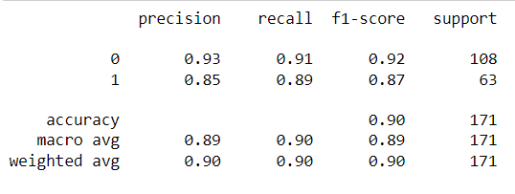
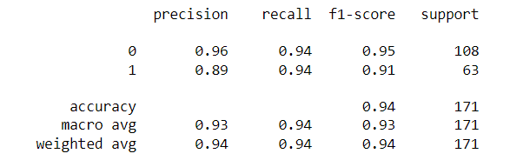
Results and Discussion
Logistic Regression: KNN: Random Forest:
Logistic Regression is better for this dataset based on accuracy score and f-1 score

